Slide 1


CAMPAIGN MANAGEMENT SYSTEM
By Dhyan Shah Priti Aghrawal Naishwita Parmar
IU1641050051 Sr.Analyst. Assistant Prof.
Indus University Gateway Corp. Indus University

Slide 2
Technologies & Project Defination
Project Technologies : .Net MVC,Web API,SQL Server,C#, HTML ,LINQ,Bootstrap,Repository Pattern - DI, Code first Approach
Project Defination : Design a Campaign Management System that will track customer response and costs for each campaign thereby promoting business and improving sales with targeted marketing campaigns.

Slide 3
Hardware & Software requirements.
Hardware Requirements :
8GB RAM, 3.00 GHz processor
Software Requirements :
Microsoft Visual Studio, SQL Server Management Studio
Platform: .Net MVC (Architecture)
Backend: SQL

Slide 4
Modules
Data import screen that will allow to import data from spreadsheet.
List of Marketing that logs type of customers record and marketing strategy used.
Campaign with basic campaign details,schedule,financial and activity details.
Quick Campaign to send emails to bulk customers.
Campaign Response Screen to track campaign responses.
User-Friendly Reports.
And some normal pages(Login,Register,...).

Slide 5
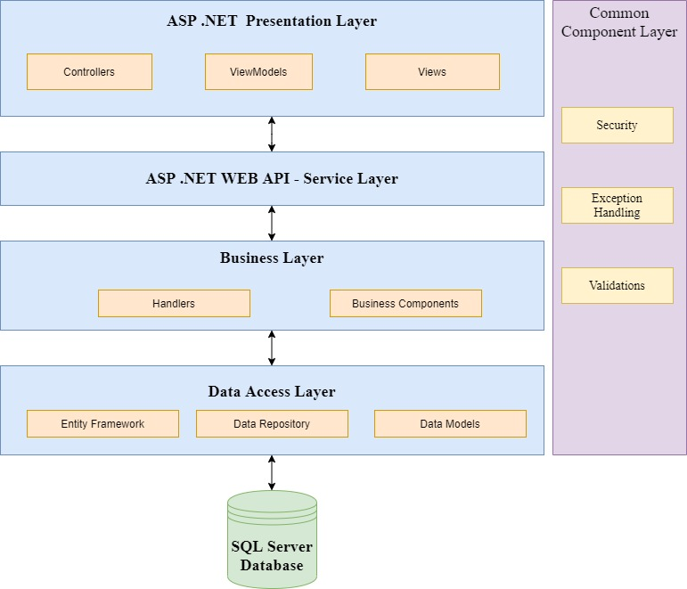
Architectural Design.

Slide 6
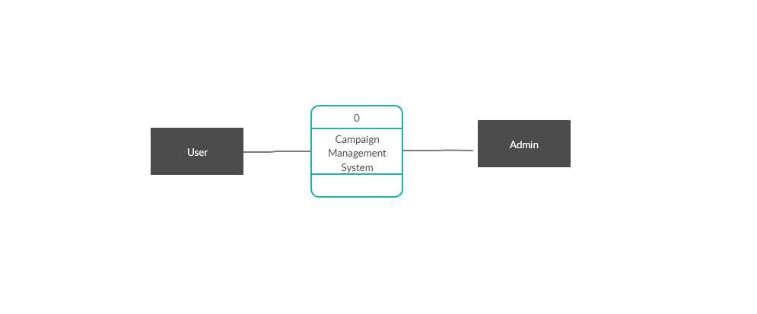
Data Flow Diagram (Context Level)

Slide 7
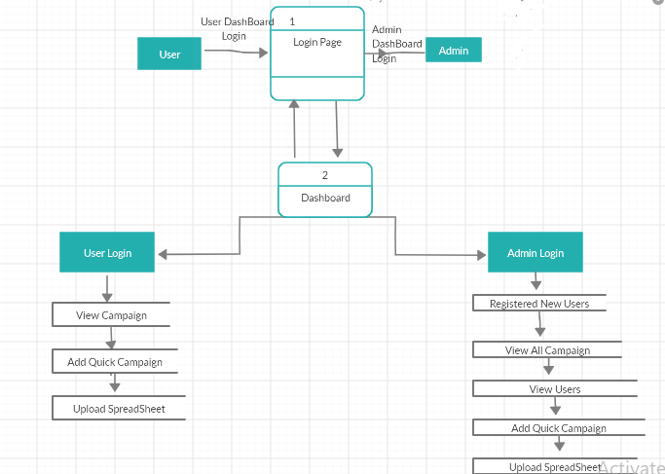
Data Flow Diagram (Level-1)

Slide 8
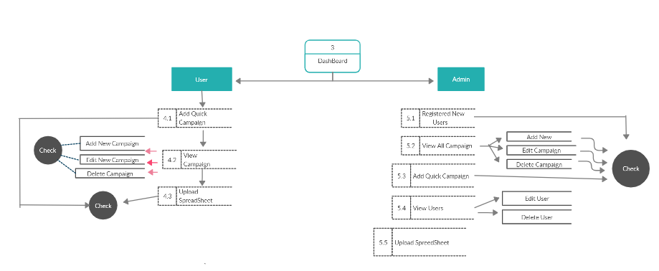
Data Flow Diagram (Level-2)

Slide 9
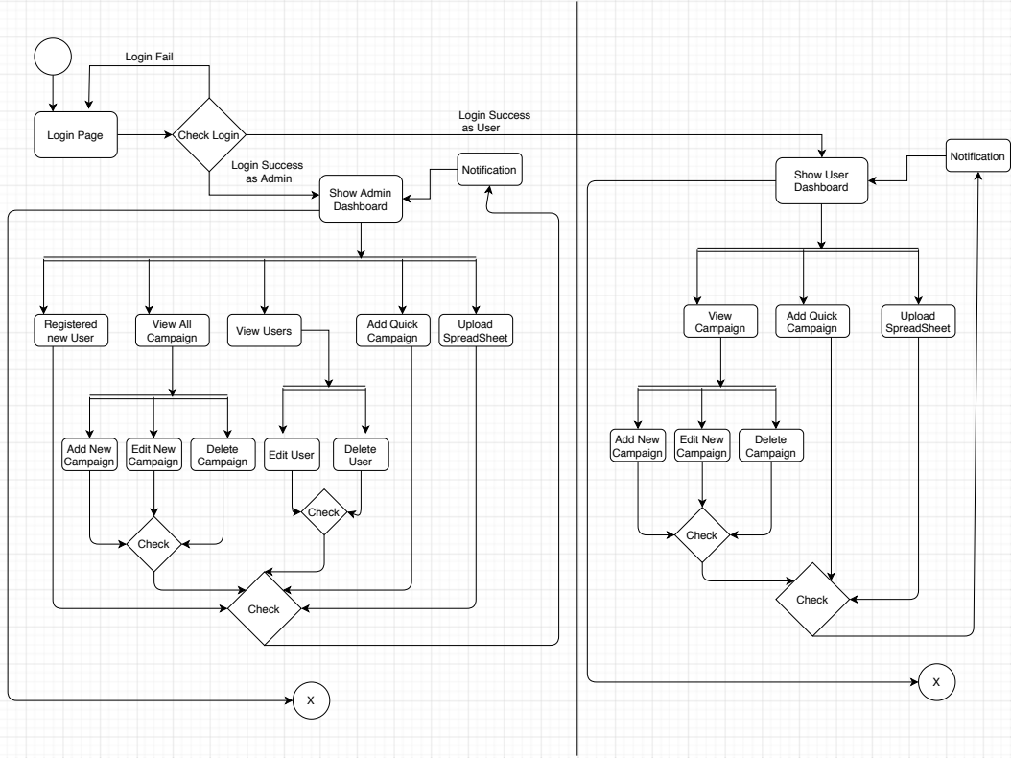
Activity Diagram.

Slide 10
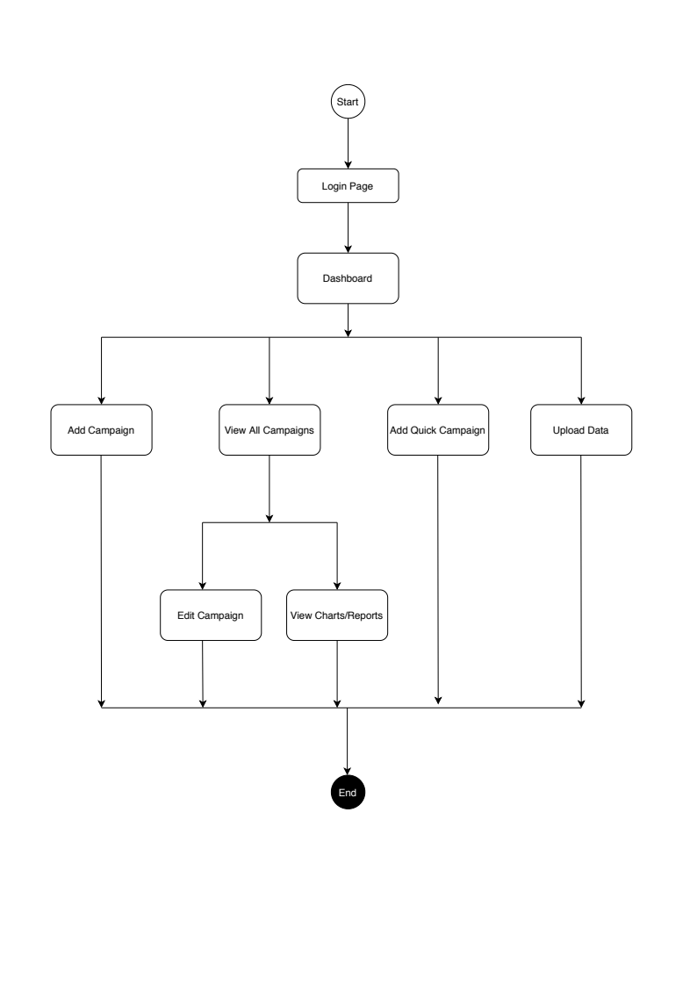
User-Flow Diagram- (Admin-Flow)

Slide 11
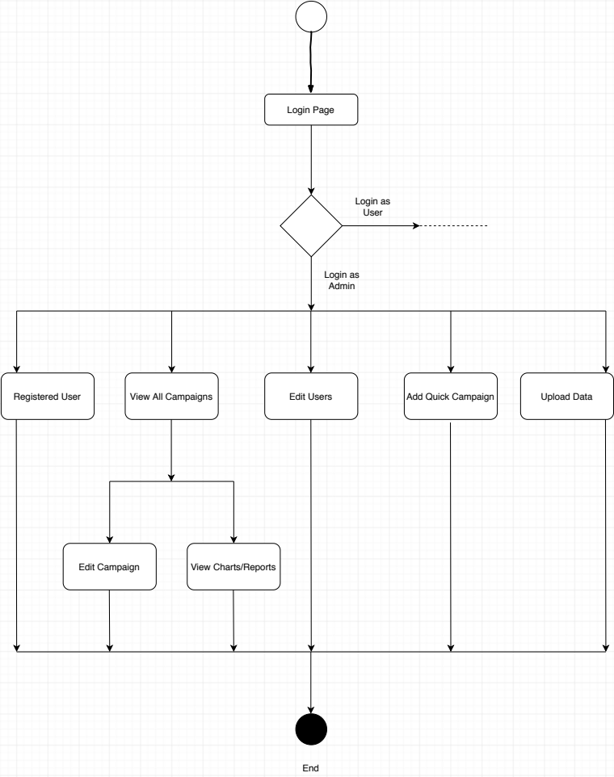
User-Flow Diagram- (User-Flow)

Slide 12
Project Functionalities
Login Page.
Registration Page (Only for Admin).
Add Campaign.
Edit Campaign.
View Campaign.
View Generated Reports & Graphs.
Quick Campaign.
Import User Data.
Assign Access Roles.

Slide 13
Limitation Future Scope.
Review of the any camping is not available. How to organize it.
We can’t predict customer feedback for the Campaign.

Slide 14
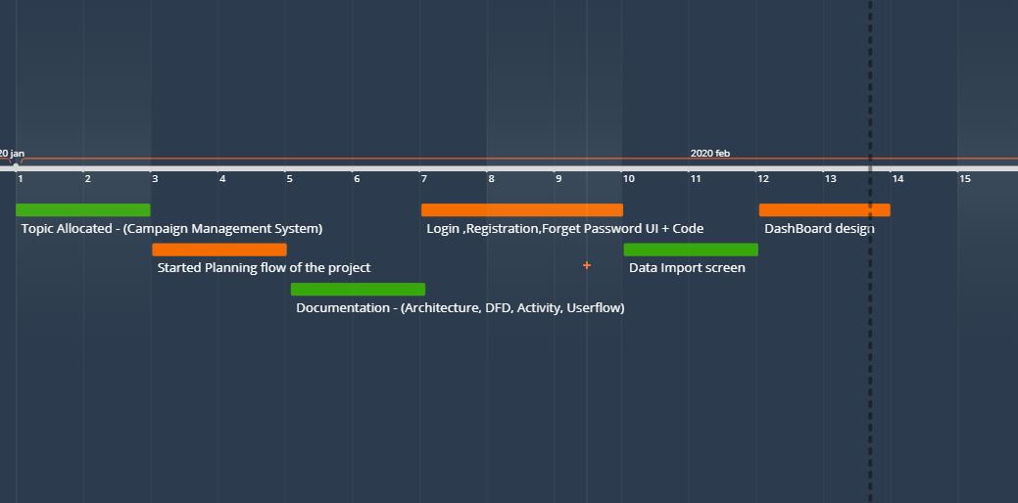
Timeline Chart.

Slide 15
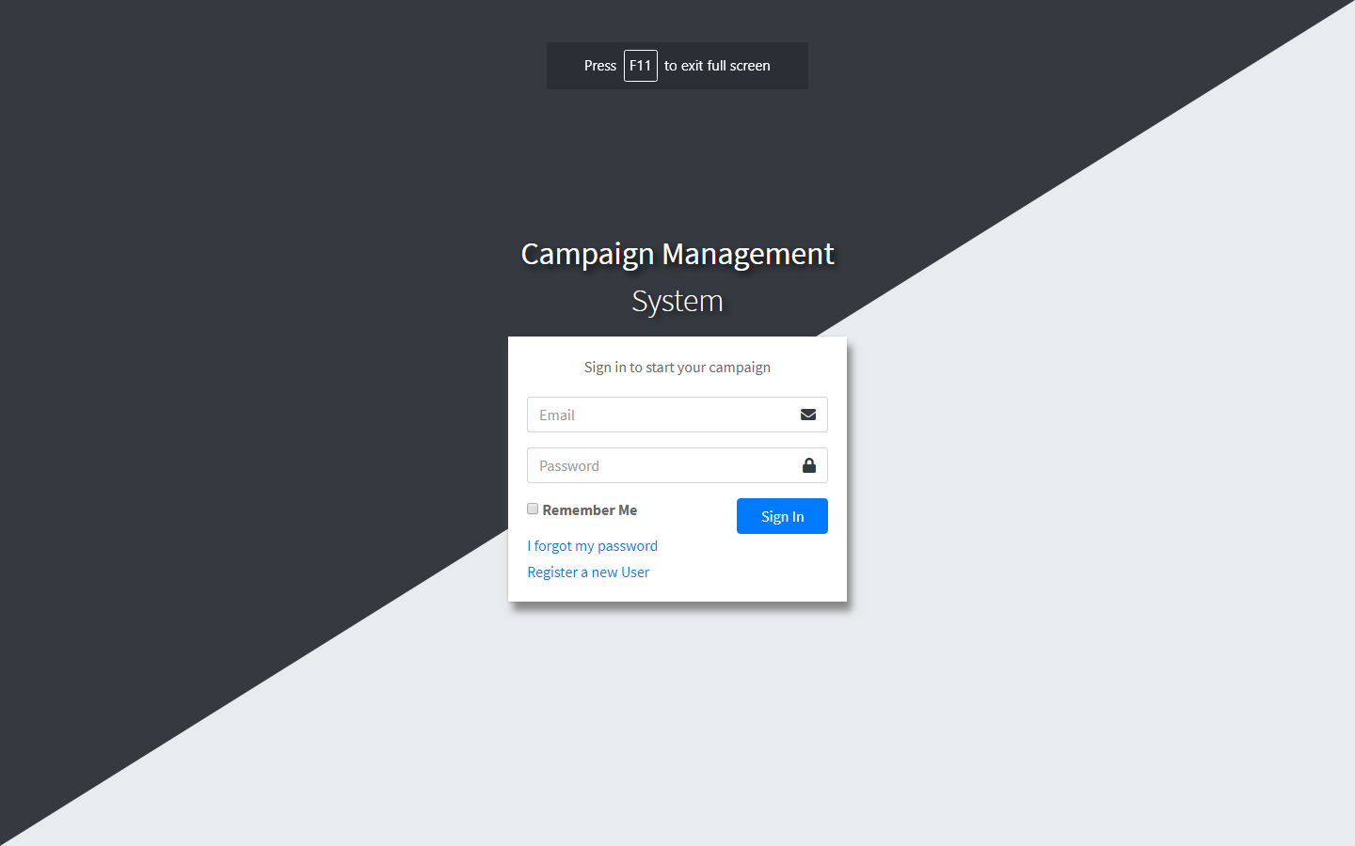
Screen Shots Of the Project.

Slide 16
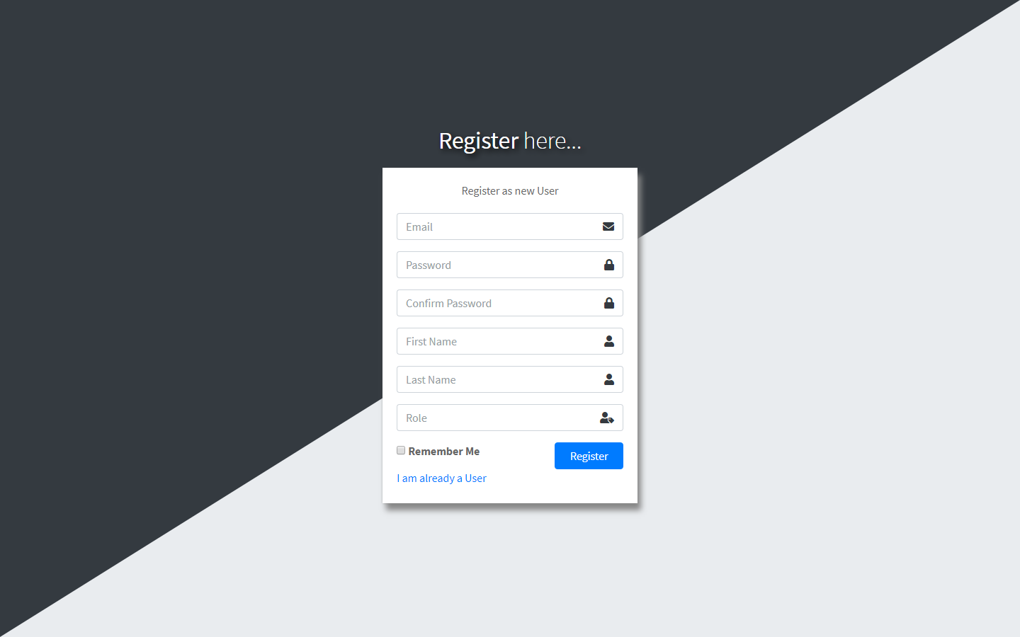

Slide 17
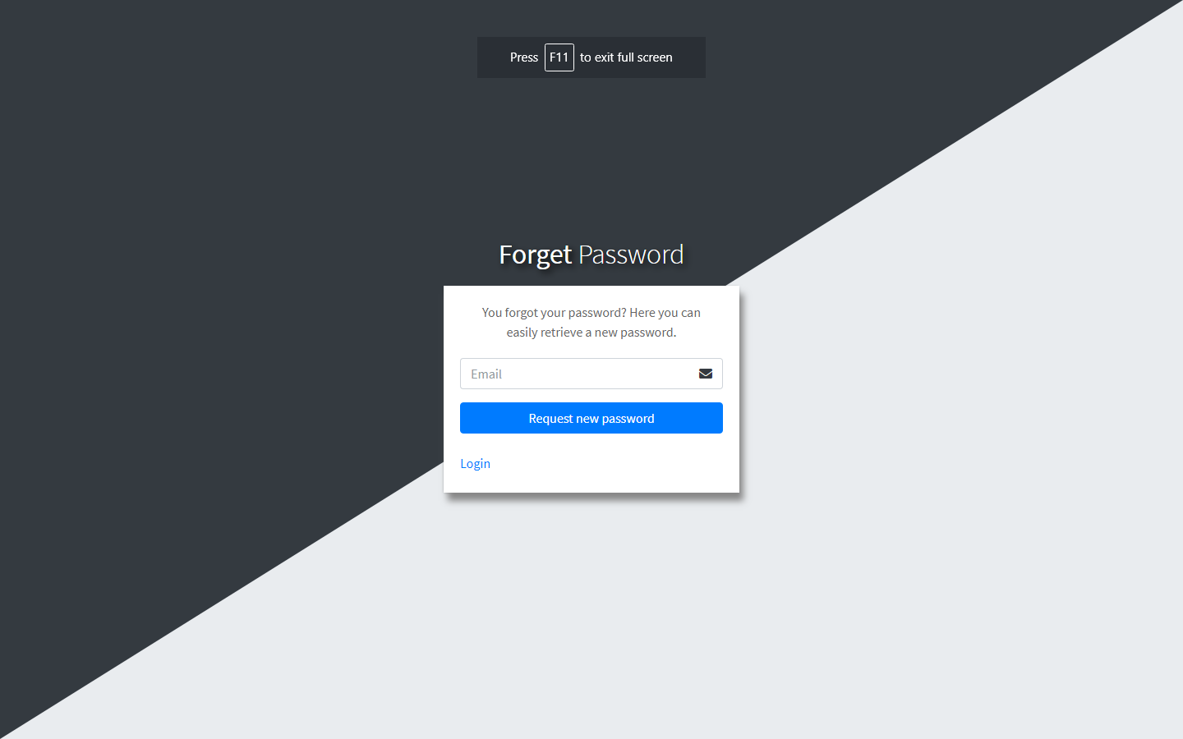

Slide 18
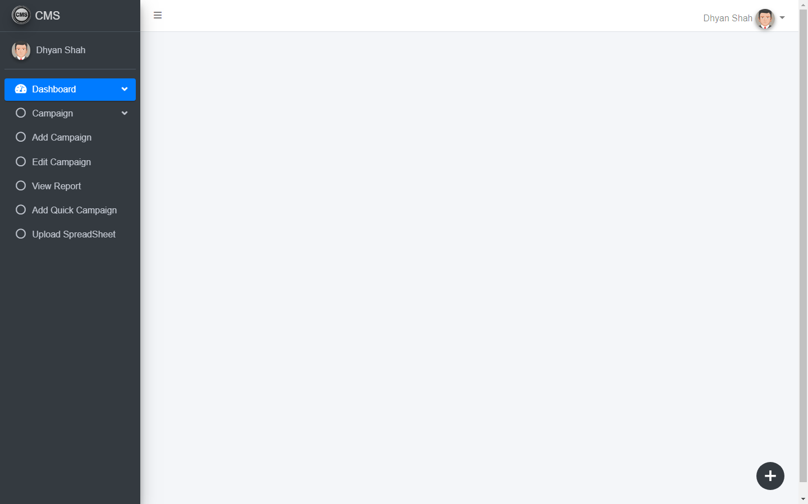

Slide 19
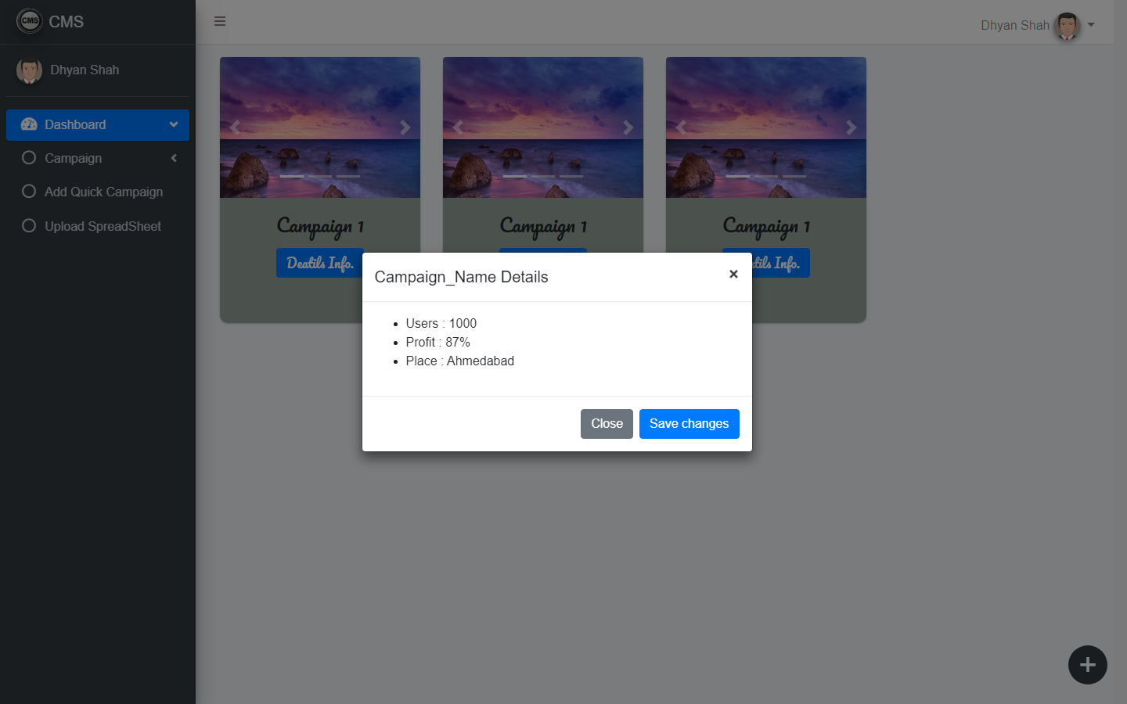

Slide 20
Refrences
https://stackoverflow.com/
https://www.tutorialspoint.com/mvc_framework/mvc_framework_introduction.
https://www.capterra.com/campaign-management-software/

Slide 21
Thank You...

